Slide 1
PRAM 2 Graph algorithms
CS121 Parallel Computing
Spring 2017

Slide 2
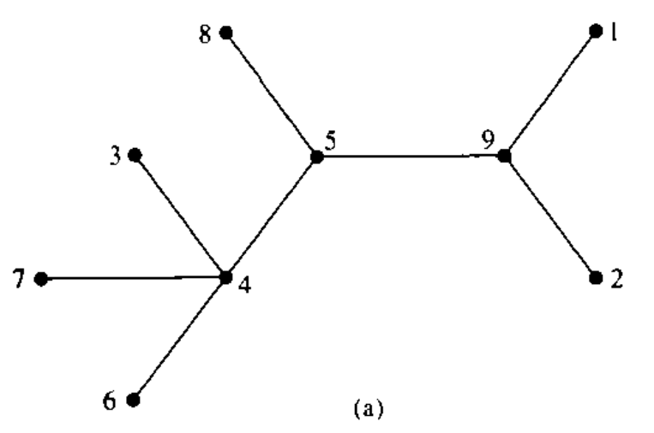
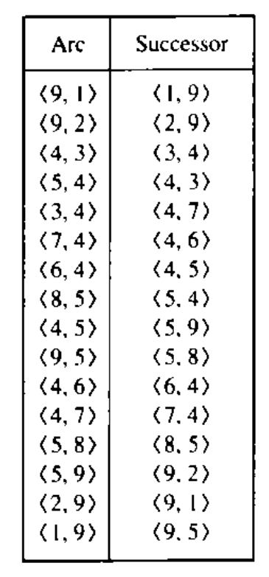
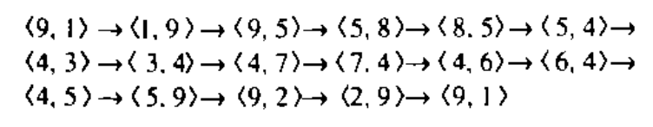
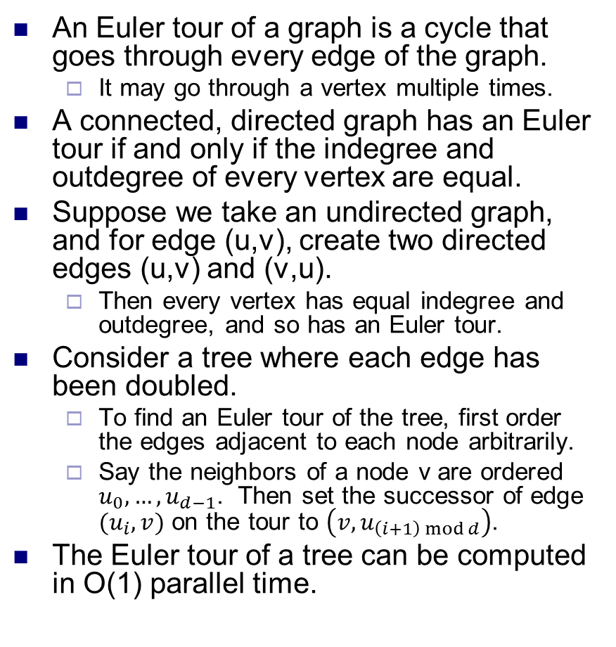
Euler tours
An Euler tour of a graph is a cycle that goes through every edge of the graph.
It may go through a vertex multiple times.
A connected, directed graph has an Euler tour if and only if the indegree and outdegree of every vertex are equal.
Suppose we take an undirected graph, and for edge (u,v), create two directed edges (u,v) and (v,u).
Then every vertex has equal indegree and outdegree, and so has an Euler tour.
Consider a tree where each edge has been doubled.
To find an Euler tour of the tree, first order the edges adjacent to each node arbitrarily.
Say the neighbors of a node v are ordered $u_{0},…, u_{d−1}$. Then set the successor of edge $(u_{i}, v)$ on the tour to $\left(v, u_{\left(i+1\right) mod d}\right)$.
The Euler tour of a tree can be computed in O(1) parallel time.
Source: Introduction to Parallel Algorithms, Jaja

Slide 3
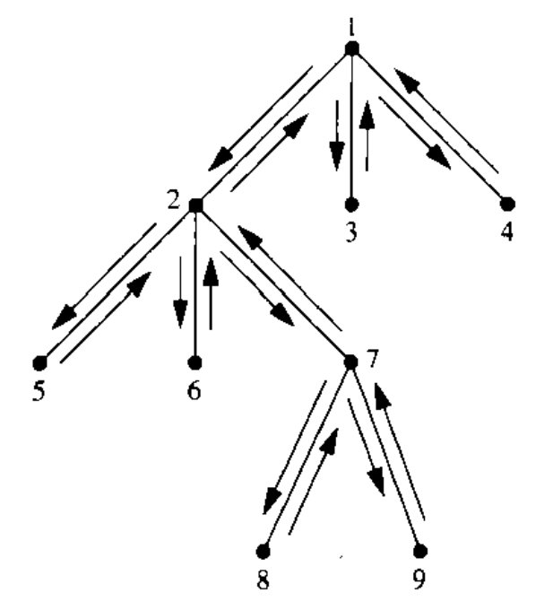
Parallel tree operations
Many operations on trees can be done in parallel using Euler tours and prefix sum.
These operations in turn are used in other parallel graph algorithms.
We first root a tree in parallel.
I.e. set an arbitrary node r as the tree’s root. Then each node v needs to compute p(v), its parent in the rooted tree.
To do this, assign a weight of 1 to each edge in an Euler tour of the tree.
Then compute the parallel prefix sum of the edges.
For each edge (u,v), set u=p(v) whenever the prefix sum of (u,v) is less than the prefix sum of (v,u).
Thus, we can root a tree with n nodes in O(log n) time and O(n) work.

Slide 4
Node depths
For each node, compute its depth in a rooted tree.
For each node v, let p(v) be its parent.
Set the weight of edge (p(v), v) to 1, an the weight of edge (v, p(v)) to -1.
Compute a parallel prefix sum of the Euler tour starting at the root.
The depth of node v is the prefix sum of edge (p(v), v).
For a tree with n nodes, this takes O(log n) time using O(n) work.

Slide 5
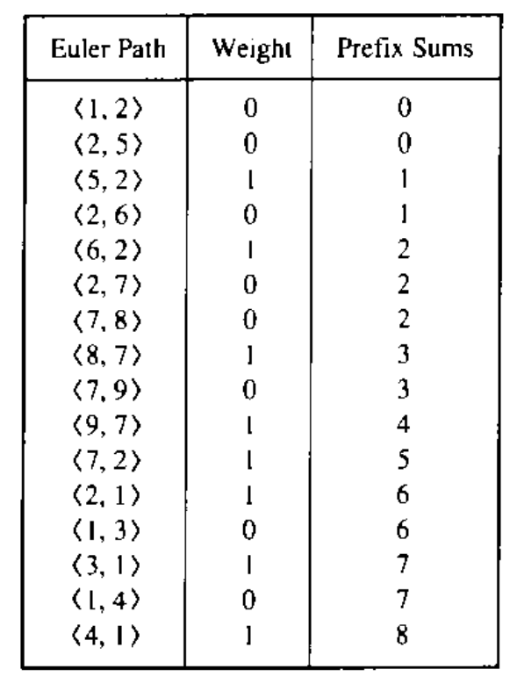
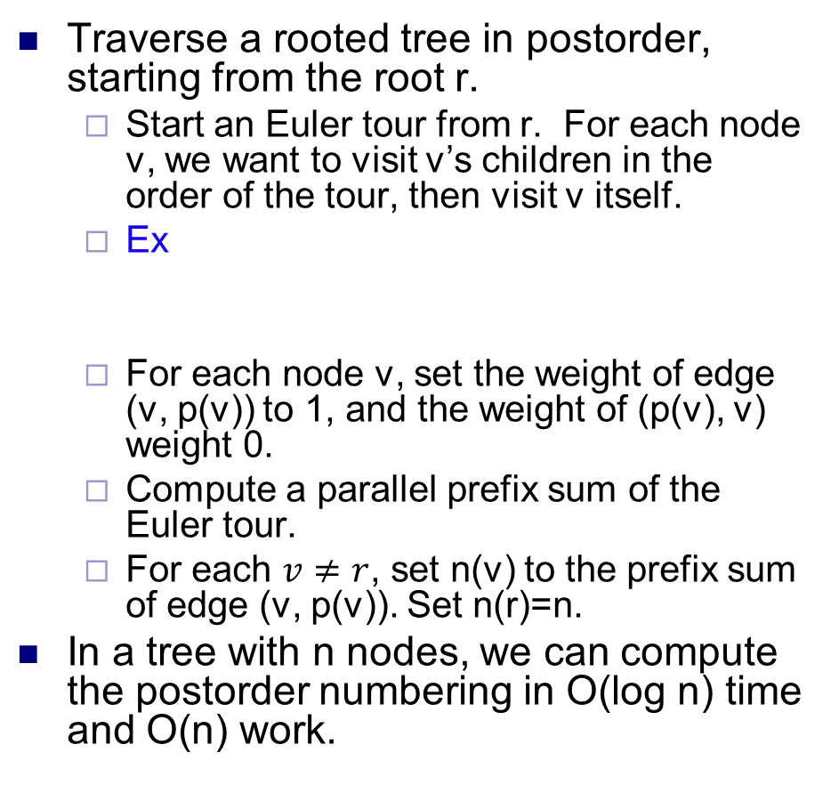
Postorder numbering
Traverse a rooted tree in postorder, starting from the root r.
Start an Euler tour from r. For each node v, we want to visit v’s children in the order of the tour, then visit v itself.
Ex
For each node v, set the weight of edge (v, p(v)) to 1, and the weight of (p(v), v) weight 0.
Compute a parallel prefix sum of the Euler tour.
For each $v≠r$, set n(v) to the prefix sum of edge (v, p(v)). Set n(r)=n.
In a tree with n nodes, we can compute the postorder numbering in O(log n) time and O(n) work.
v | 1 | 2 | 3 | 4 | 5 | 6 | 7 | 8 | 9
n(v) | 9 | 6 | 7 | 8 | 1 | 2 | 5 | 3 | 4

Slide 6
Number of descendants
For each node v in a rooted tree, compute the number of nodes in the subtree rooted at v.
To do this, we compute prefix sums as in the postorder numbering.
Then the number of descendants of a node v equals the prefix sum of (v, p(v)) minus the prefix sum of (p(v), v).
In a tree with n nodes, we can compute the number of descendants in O(log n) time and O(n) work.

Slide 7
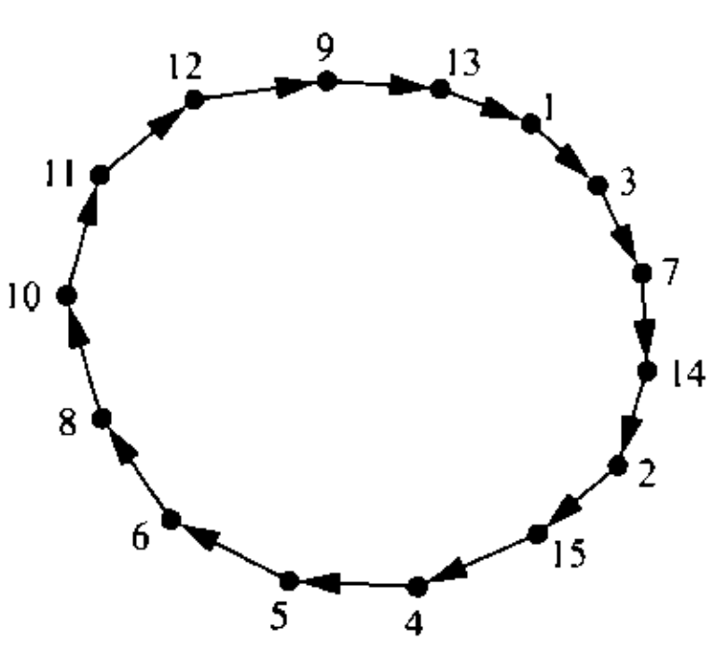
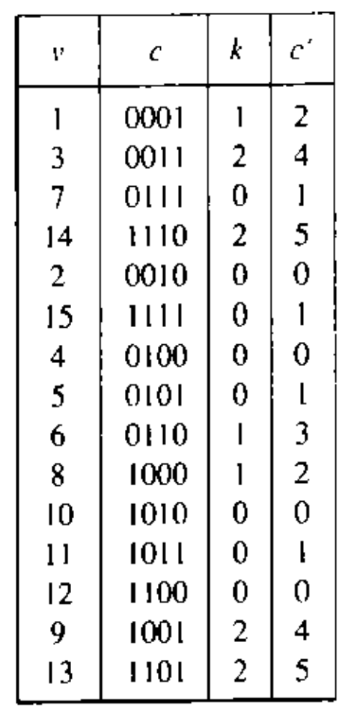
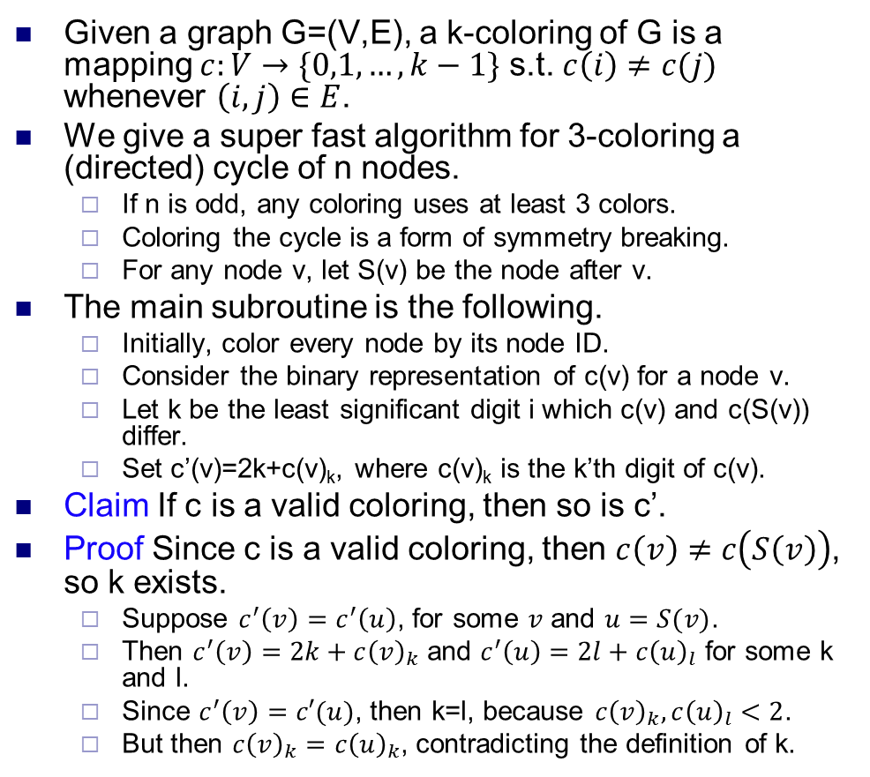
Coloring a cycle
Given a graph G=(V,E), a k-coloring of G is a mapping $c:V→\{0,1,…, k−1\}$ s.t. $c\left(i\right)≠c(j)$ whenever $\left(i,j\right)∈E$.
We give a super fast algorithm for 3-coloring a (directed) cycle of n nodes.
If n is odd, any coloring uses at least 3 colors.
Coloring the cycle is a form of symmetry breaking.
For any node v, let S(v) be the node after v.
The main subroutine is the following.
Initially, color every node by its node ID.
Consider the binary representation of c(v) for a node v.
Let k be the least significant digit i which c(v) and c(S(v)) differ.
Set c’(v)=2k+c(v)_{k}, where c(v)_{k} is the k’th digit of c(v).
Claim If c is a valid coloring, then so is c’.
Proof Since c is a valid coloring, then $c\left(v\right)≠c\left(S\left(v\right)\right)$, so k exists.
Suppose $c^{′}\left(v\right)=c^{′}\left(u\right)$, for some $v$ and $u=S(v)$.
Then $c^{′}\left(v\right)=2k+c{\left(v\right)}_{k}$ and $c^{′}\left(u\right)=2l+c{\left(u\right)}_{l}$ for some k and l.
Since $c^{′}\left(v\right)=c′(u)$, then k=l, because $c{\left(v\right)}_{k}, c{\left(u\right)}_{l}<2$.
But then $c{\left(v\right)}_{k}=c{\left(u\right)}_{k}$, contradicting the definition of k.

Slide 8
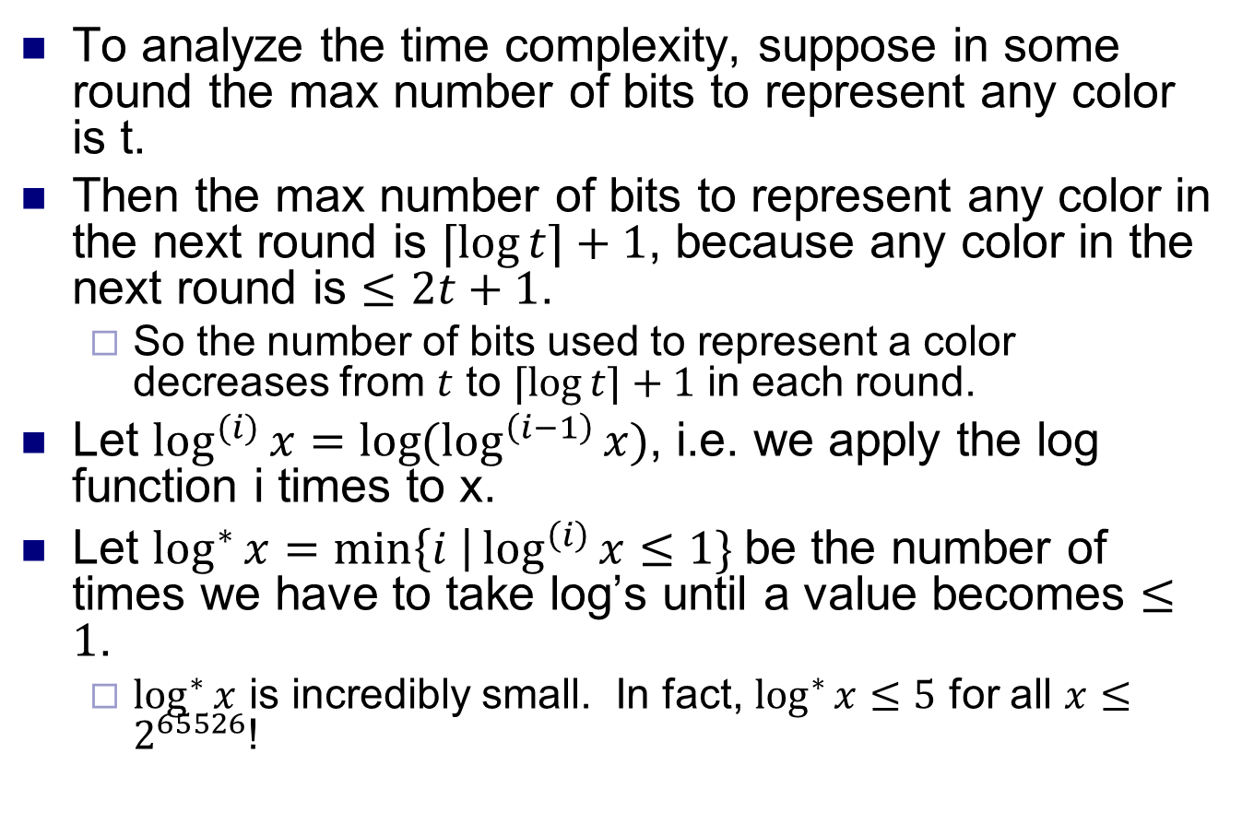
Coloring a cycle
To analyze the time complexity, suppose in some round the max number of bits to represent any color is t.
Then the max number of bits to represent any color in the next round is $⌈\log{t⌉+1}$, because any color in the next round is $≤2t+1$.
So the number of bits used to represent a color decreases from $t$ to $⌈\log{t⌉+1}$ in each round.
Let $\log^{(i)}{x=\log{(\log^{\left(i−1\right)}{x)}}}$, i.e. we apply the log function i times to x.
Let $\log^{∗}{x=\min\left\{i \right|\log^{\left(i\right)}{x≤1\} }}$be the number of times we have to take log’s until a value becomes $≤1$.
$\log^{∗}{x}$ is incredibly small. In fact, $\log^{∗}{x≤5}$ for all $x≤2^{65526}$!

Slide 9
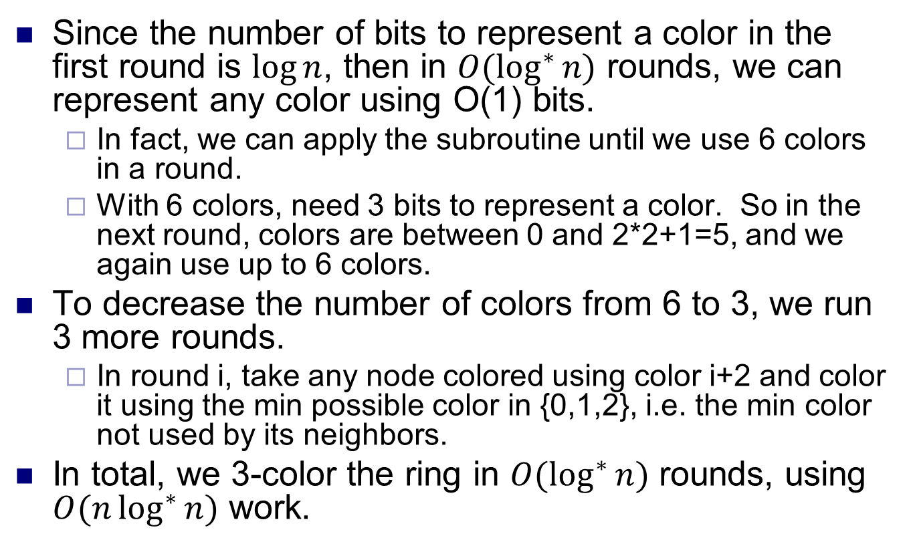
Coloring a cycle
Since the number of bits to represent a color in the first round is $\log{n}$, then in $O(\log^{∗}{n)}$ rounds, we can represent any color using O(1) bits.
In fact, we can apply the subroutine until we use 6 colors in a round.
With 6 colors, need 3 bits to represent a color. So in the next round, colors are between 0 and 2*2+1=5, and we again use up to 6 colors.
To decrease the number of colors from 6 to 3, we run 3 more rounds.
In round i, take any node colored using color i+2 and color it using the min possible color in {0,1,2}, i.e. the min color not used by its neighbors.
In total, we 3-color the ring in $O(\log^{∗}{n)}$ rounds, using $O(n\log^{∗}{n})$ work.

Slide 10
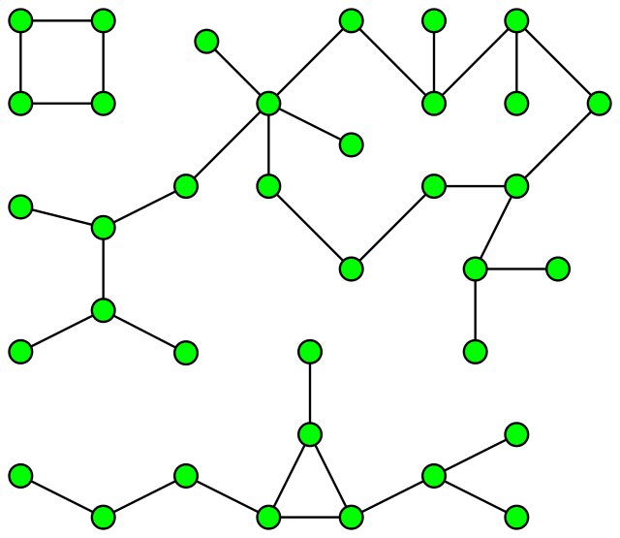
Connected components
Given an undirected graph, partition it into maximal sets of nodes that are connected to each other.
Can be solved sequentially in O(m) time using BFS / DFS.
m is number of edges, n is number of vertices.
However, no efficient BFS / DFS PRAM algorithms known.
Instead, use graph contractions.
In each phase, merge (contract) a set of connected nodes into a supernode.
Form a contracted graph on the supernodes, then apply algorithm recursively.
Eventually each connected component is contracted to one node.
Many different algorithms, depending on which nodes they contract.

Slide 11
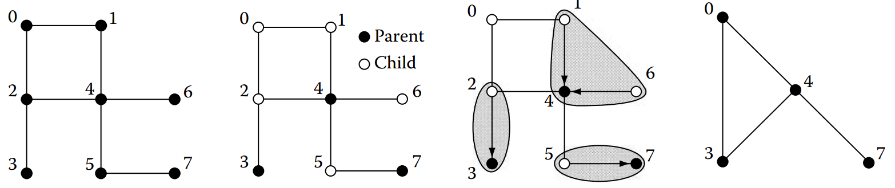
Randomized parallel algorithm
Break graph into star graphs and contract each star.
In each phase, do the following steps in parallel.
Every node flips a coin and chooses to be a parent or child node.
Each child node points to a parent node it’s connected to.
Now have a set of stars, with the parent nodes as the centers.
If child not connected to any parent node, it forms its own star.
Contract each star to its center, then apply algorithm recursively.
Label all nodes in star by the label of the parent.
Keep the edges between differently labeled nodes.
After recursion returns, each child with a parent again takes parent’s label, which might have changed.
Source: Algorithms and Theory of Computation Handbook, Chapter 25

Slide 12
Implementation
Use n+m processors, one processor for each vertex and edge.
Call these E and V procs, resp.
Each V proc has a label which can change over time.
Each E proc responsible for edge (u,v), where u, v are V procs.
V and E procs may become inactive over time.
In each phase, each active V proc flips a coin to decide if it’s a child or parent proc.
Each active E proc (u,v) checks if u is a child proc and v is a parent (or vice versa).
If so, it sets u’s label to v (or v’s label to u).
Another E proc (u,v’) could set u’s label to v’. In this case, either the v or v’ write succeeds.

Slide 13
Implementation
Each parent V proc, or child V proc whose label didn’t change (i.e. it had no parent), stays active.
Other V procs become inactive.
Each active E proc (u,v) where u, v have different labels stays active.
Other E procs become inactive.
From now on, E will be responsible for V processes (u’,v’), where u’ and v’ are the labels of u and v, resp.
The active V and E procs run the algorithm recursively.
After recursion returns, inactive E procs (u,v) (where u is the child) write v’s label to u.
At end, all V procs in a connected component have same label.

Slide 14
Complexity
Key fact is that number of active V procs decreases by 1/4 fraction in expectation each phase.
A V proc becomes inactive if it’s a child node and one its neighbors is a parent node.
The former probability is 1/2, and the latter is ≥ 1/2.
Thus each V proc becomes inactive with probability ≥ 1/4.
With high probability, after O(log n) phases, there’s only one V proc and recursion ends.
Each phase takes O(1) time, and does O(m+n) work.
Total time is O(log n), total work is O((m+n) log n).
This algorithm isn’t work efficient.
There exist work efficient randomized CC algorithms.

Slide 15
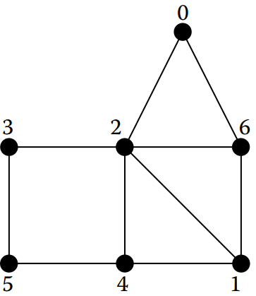
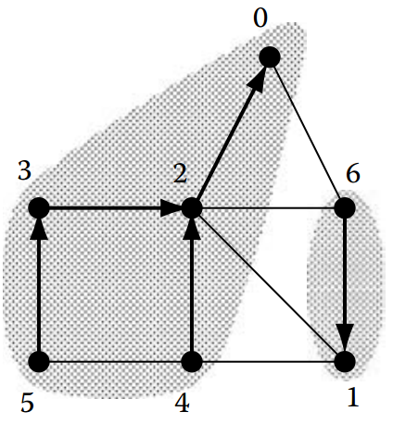
Deterministic parallel algorithm
Again work in phases, with following parallel steps.
Each node points to a neighbor with lower ID.
This breaks graph into a directed forest.
Contract each forest to the lowest ID node using pointer jumping.
Recurse on contracted graph.

Slide 16
Implementation
As before, use n+m procs, for V and E.
But now, V procs always active. E procs may become inactive.
Each E proc (u,v) checks if u<v, and if so sets v’s label to u.
Again, conflicts resolved arbitrarily.
V procs then apply pointer jumping on the labels, taking the label of the proc it points to.
Each active E proc (u,v) where u, v have different labels stays active. Other E procs become inactive.
From now on, E will be responsible for V processes (u’,v’), where u’ and v’ are the labels of u and v, resp.
There may be multiple E procs responsible for same (u’,v’).
The V procs and active E procs run algorithm recursively.
Note that in recursive call, all V procs apply pointer jumping.

Slide 17
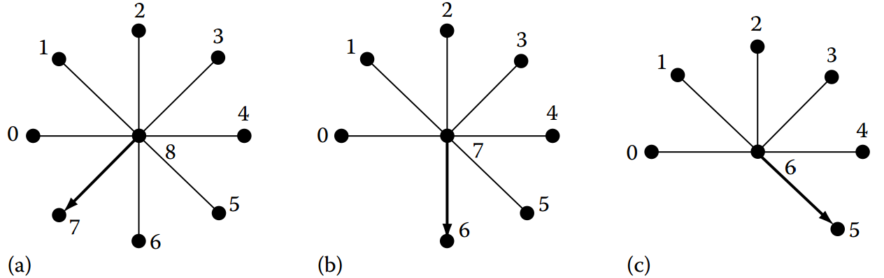
Complexity
The basic algorithm may take O(n) time on the graph below.
But notice that if we made nodes point to higher neighbors, the graph would be solved in O(1) time.
In each phase, if we consider either having nodes point to smaller neighbors, or pointing to higher neighbors, in one case ≥ n/2 nodes point to another node.
Thus the algorithm finishes in O(log n) phases.
Each phase does pointer jumping, which takes O(log n) time and O(n log n) work.
Total time is O(log² n), and work is O((m+n log n) log n).

Slide 18
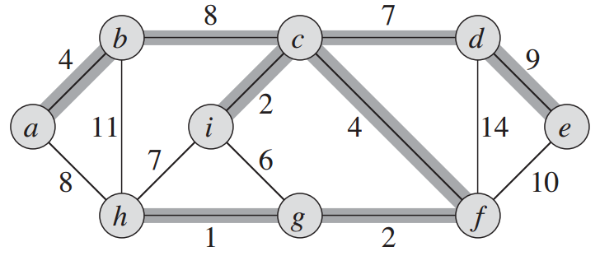
Minimum spanning tree
Given an undirected graph with edge weights, an MST is a connected subgraph containing all the vertices, which has minimum total weight.
Can be solved in O(m + n log n) time sequentially by a greedy algorithm.
Key property is that for any set of vertices W, the minimum cost edge from W to V \ W is in the MST.
So for any vertex v, min cost edge containing v is in MST.
Will describe a parallel MST algorithm based on the randomized parallel algorithm for connected component.
Source: Introduction to Algorithms, Cormen et al.

Slide 19
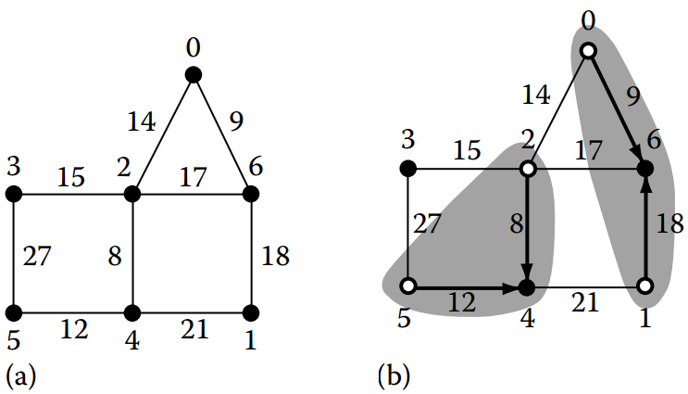
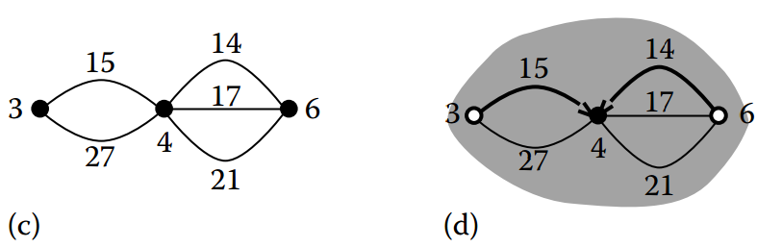
Randomized parallel algorithm
Each node randomly chooses to be a parent or child node.
Each child node u finds min weight incident edge (u,v), and points to v if v is parent.
This forms a set of stars with parents as centers.
If v isn’t a parent, u forms its own star.
Contract each star to the parent, and run algorithm recursively.
Finding min weight incident edge quickly is a little tricky.
One possibility is to use priority CRCW.
Presort the edges by nondecreasing weight. Then when each E proc (u,v) writes to u, min weight edge wins.

Slide 20
Complexity
At least 1/4 of vertex processors become inactive each phase in expectation.
Given a node u and min weight edge (u,v), there’s 1/4 probability u is child and v is parent.
Thus, there are O(log n) phases with high probability.
Finding min weight incident edge takes O(1) time after presorting edge weights.
Total time is O(log n), total work is O((m+n) log n).

